Slide 1
How covid-19 lockdowns affect the average lifespan
By: Jack Hartigan, Summer Xia, Ben Kaplan, Emma Sargent, Hansen Guo, Abdur Khan, Matias Bermudez

Slide 2
Introduction/Hypotheses
12+ months of COVID-19, USA heavily affected
Lockdowns as a solution for stopping the spread of COVID-19
Hypothesis: Lockdowns will decrease death rates in the United States.

Slide 3
Related Literature
Gupta et al. (2004) studied the economic impact of quarantine for SARS in and estimated that when the transmission rate of infection was 0.08, Toronto would save $274 million by implementing quarantine measures at the second wave of infection.
Strumpf et al. (2017) found that a 1% increase in the U.S. metropolitan area unemployment rate was associated with a decrease in all-cause mortality of 3.95 deaths per 100,000 person years, or 0.5% during 2008 recession using fixed effects regression models.
Atalan (2020) found that the lockdown days in 49 countries were significantly correlated with COVID-19 cases with the unconstrained correlation value of −0.9126.
Limitations: cases vs. COVID-related deaths
Our current analysis looks at the impact of different levels of COVID-19 lockdowns on mortality rates in U.S.

Slide 4
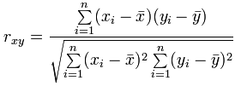

MVP
Correlation Analysis
Hypothesis Test to test the significance of the correlations
Null-hypothesis: There is no correlation between the two variables

Slide 5
Data Collection
State Population is from: https://www.census.gov/data/tables/time-series/demo/popest/2010s-state-total.html#par_textimage
Death rate is from: https://data.cdc.gov/NCHS/Weekly-Counts-of-Deaths-by-State-and-Select-Causes/muzy-jte6
Age is from: https://data.cdc.gov/NCHS/Provisional-COVID-19-Death-Counts-by-Sex-Age-and-S/9bhg-hcku
Unemployment rate is from: https://www.bls.gov/web/laus/laumstrk.htm
Lockdown ranking is from: https://wallethub.com/edu/states-coronavirus-restrictions/73818
Density is from: https://en.wikipedia.org/wiki/List_of_states_and_territories_of_the_United_States_by_population_density
Annual Unemployment Rate by State: https://www.icip.iastate.edu/tables/employment/unemployment-states
Suicide Data: https://data.cdc.gov/NCHS/NCHS-Leading-Causes-of-Death-United-States/bi63-dtpu
County Data Deaths: https://raw.githubusercontent.com/CSSEGISandData/COVID-19/master/csse_covid_19_data/csse_covid_19_time_series/time_series_covid19_deaths_US.csv
Density County Data: https://www.devinbunten.com/data
Drug Deaths: https://www.cdc.gov/nchs/data/databriefs/db329_tables-508.pdf#page=3
Homiside Rate: https://www.macrotrends.net/countries/USA/united-states/murder-homicide-rate
Nursing Home Data: https://data.cms.gov/Special-Programs-Initiatives-COVID-19-Nursing-Home/COVID-19-Nursing-Home-Dataset/s2uc-8wxp

Slide 6
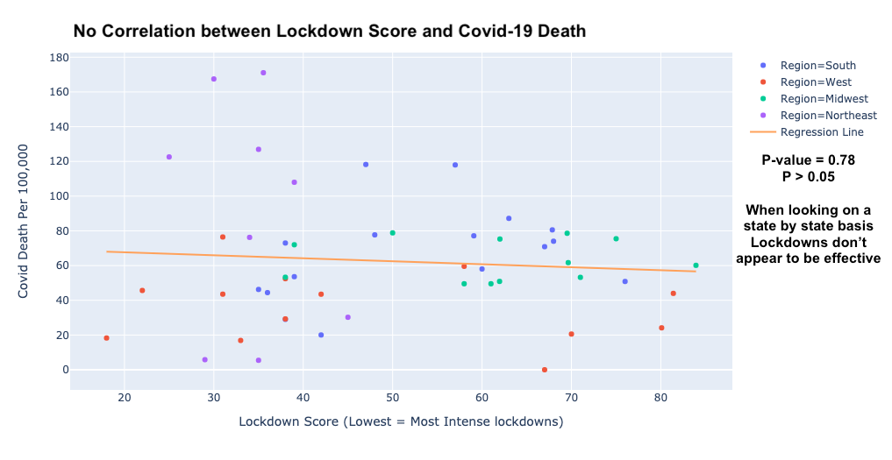
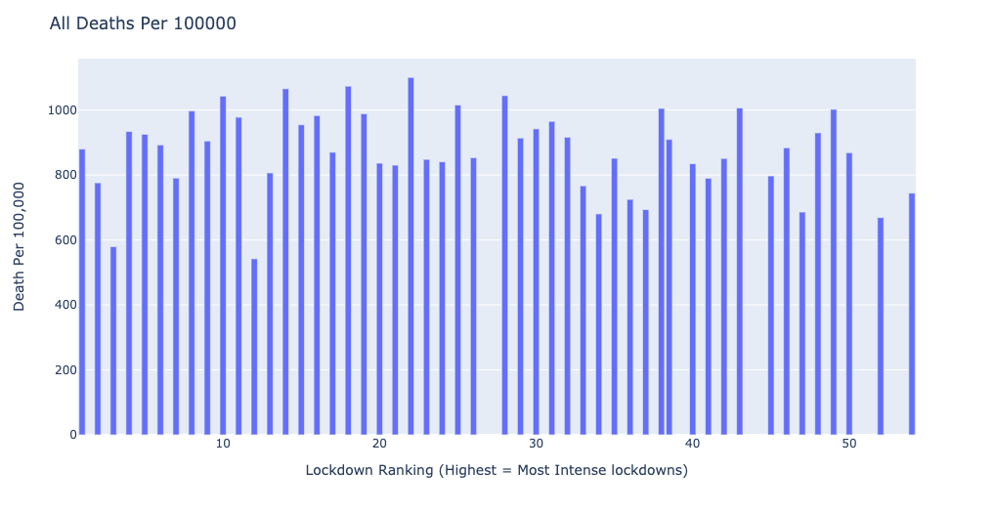
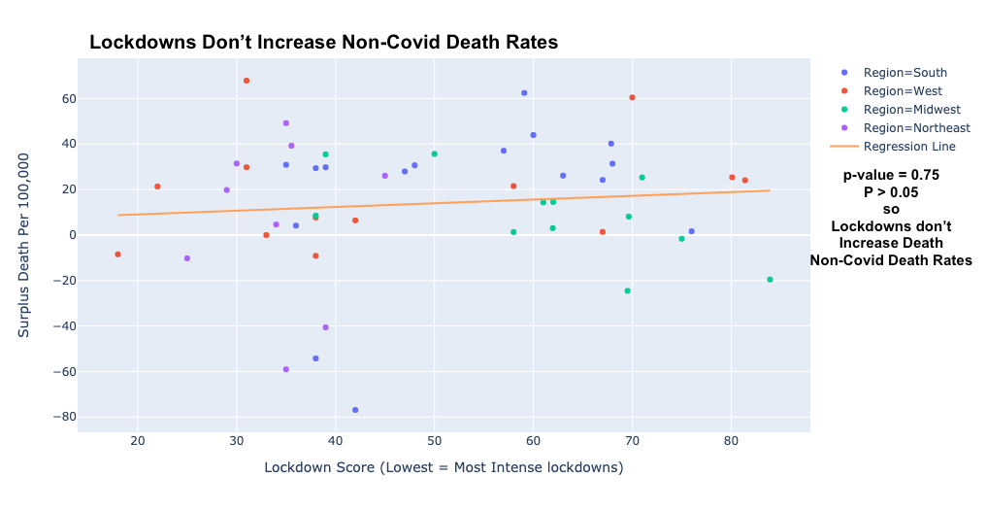
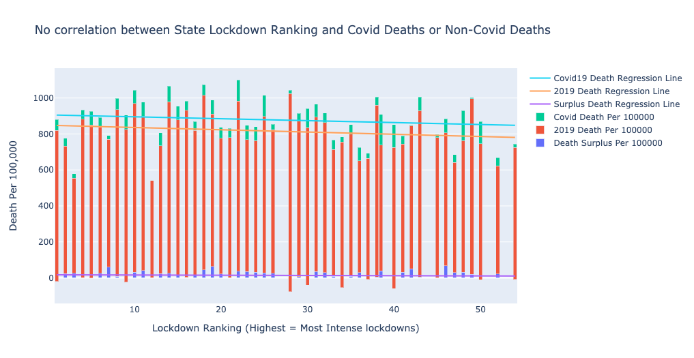
Diving Into State Death Data

Slide 7
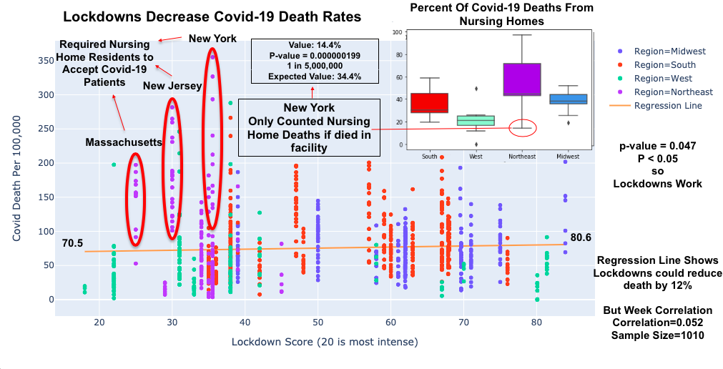

Slide 8
Conclusion
Lockdowns:
Flatten the Curve and Decrease Death Rates (Predicted Decrease: 33%)
Don’t increase Non-Covid Death Rates
Unemployment Rates:
Don’t Increase Suicide, Drug Overdose, or Homicide Rates (2008 Recession Data)
Nursing Homes:
Projected Deaths: 13% of Nursing Home Residents in New York
North-East High Death Cause:
Not Due to Density or Nursing Home Failures
More Data is Needed:
Specific Death Data (Ex. Suicide Rates, Drug Overdoses)
Further Investigate:
Individual Lockdown Aspects (Ex. Mask Mandate, Bar Closures)

Slide 9
References:
Atalan, Abdulkadir. “Is the lockdown important to prevent the COVID-9 pandemic? Effects on psychology, environment and economy-perspective.” Annals of medicine and surgery (2012) vol. 56 (2020): 38-42. doi:10.1016/j.amsu.2020.06.010
Gupta AG, Moyer CA, Stern DT. The economic impact of quarantine: SARS in Toronto as a case study. J Infect. 2005 Jun;50(5):386-93. doi: 10.1016/j.jinf.2004.08.006. PMID: 15907545; PMCID: PMC7112515.
Strumpf EC, Charters TJ, Harper S, Nandi A. Did the Great Recession affect mortality rates in the metropolitan United States? Effects on mortality by age, gender and cause of death. Soc Sci Med. 2017 Sep;189:11-16. doi: 10.1016/j.socscimed.2017.07.016. Epub 2017 Jul 21. PMID: 28772108.

